Slide 1
Ruby
Chris Sass

Slide 2
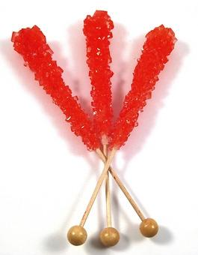
Red Colored Rock Candy: Ruby is Sweet :)
What is Ruby?
"Ruby is... a dynamic, open source language with a focus on simplicity and productivity. It has a elegant syntax that is natural to read and easy to write."

Slide 3
Every Class inherits from Object
class Foo
end
Foo.methods
# => [:allocate, :new, :superclass...
Foo.methods.size # => 97
Foo.instance_methods
# => [[:nil?, :===, :=~, :!~, :eql?...
Foo.instance_methods.size
# => 56
Foo.superclass == 5 # => Object

Slide 4

Symbols are not just a percussion instrument
In Ruby :symbols are a great way to keep track of names of things
Strings are not the best flags
Efficient comparison
Only one instance for each

Slide 5
Symbols are not just a percussion instrument
'flag_value' == 'flag_value'
# => true (the same value)
'flag_value'.equal? 'flag_value'
# => false (diffe instance of String)
:flag_value == :flag_value
# => true (the same value)
:flag_value.equal? :flag_value'
# => true (same instance of Symbol)
1337.send(:to_s)
# => "1337" (argument is a method's name)

Slide 6
Loopy
Ranges & Enumerables
Performs like it reads :)
5.times do
print "w3w7 "
end
w3w7 w3w7 w3w7 w3w7 w3w7 => 5
3.downto(1) { |i| print i.to_s + " " }
3 2 1 => 3
Ranges are nice as well too
(4..7).each { print i }
4567 => 4..7

Slide 7
Loopy
Ranges & Enumerables
Splat ranges to an array
[*0..5]
w3w7 w3
w3w7 w3w7 w3w7 w3w7 w3w7 => 5
3.downto(1) { |i| print i.to_s + " " }
3 2 1 => 3

Slide 8
Pythons
Can get sick too

Slide 9
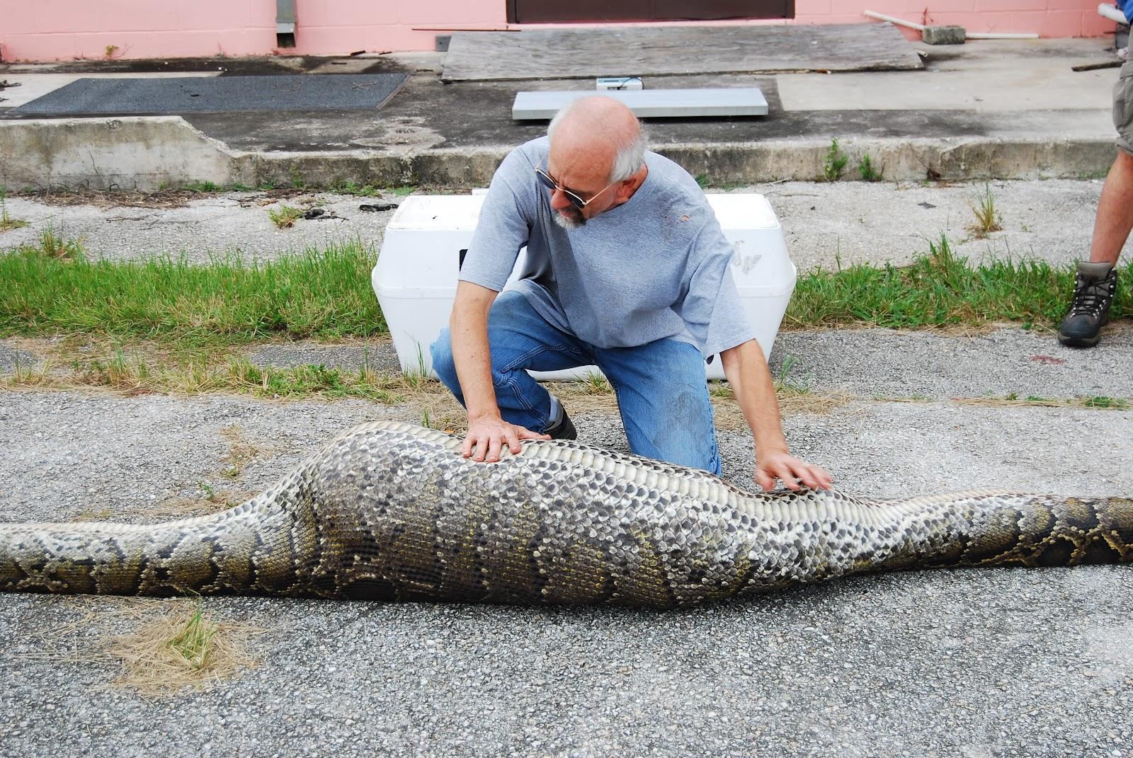

Slide 10
True = False
(Python's internals still return the real True)
>>> True = False
>>> True == False
True
>> 1 == 1
True
(1 == 1) == True
False

Slide 11
2 = 3
>>> import ctypes
>>> new_value = 2
>>> ob_ival_offset = ctypes.sizeof(ctypes.c_size_t) + \
... ctypes.sizeof(ctypes.c_voidp)
>>> ob_ival = ctypes.c_int.from_address(id(new_value)+ob_ival_offset)
>> ob_ival
c_int(2)
>>> ob_ival.value = 3

Slide 12
2 = 3
>>> print 2+2
6
>>> 2 == 3
True
(stolen from http://hforsten.com/redefining-the-number-2-in-python.html )

Slide 13
Custom Namespace
from collections import MutableMapping
class CaseInsensitiveNamespace(MutableMapping):
def __init__(self):
self.ns = {}
def __getitem__(self, key):
return self.ns[key.lower()]
def __delitem__(self, key):
del self.ns[key.lower()]
def __setitem__(self, key, value):
self.ns[key.lower()] = value
def __len__(self):
return len(self.ns)
def __iter__(self):
return iter(self.ns)

Slide 14
Case Insensitive!
exec '''
foo = 42
Bar = 23
print (Foo, BAR)
''' in {}, CaseInsensitiveNamespace()

Slide 15
1 + 2 = -1 (thanks, AST)
>>> import ast
>>> x = ast.parse('1 + 2', mode='eval')
>>> x.body.op = ast.Sub()
>>> eval(compile(x, '<string>', 'eval'))
-1

Slide 16
Bad Ideas
Import code directly from Github
Patch __builtins__ to add new built-in functions
Implicit Self
Much much more!
Slides:
http://www.scribd.com/doc/58306088/Bad-Ideas
Video:
http://ep2011.europython.eu/conference/talks/5-years-of-bad-ideas

Slide 17
Sick Javascript
"foo".blink();

Slide 18
PHP
Will turn you Sick && Insane

Slide 19
P. P. P. PHP
1) PHP will treat undefined constants as a bare word (but throws a notice)
+
2) You can silence everything (notices included) with @
=
@print(hello);
@print(PHPはありえへん);

Slide 20
PHP: Never Say NO
NO: Variables that start with a number
$1 = "fish";
var_dump($1);
// PHP Parse error: syntax error, unexpected
// T_LNUMBER, expecting T_VARIABLE
// or '$' in ...

Slide 21
PHP: Never Say NO
YES: Variables that start with a number
// since ${'a'} is same as $a,
${1} = 'wat';
var_dump(${1});
// string(3) "wat"

Slide 22
Neither P in PHP is Parser
here are some functions:
list()
empty()
array()
isset()

Slide 23
Neither P in PHP is Parser
They are handled by the parser:
empty($var1 || $var2)
// Parse error: syntax error, unexpected
// T_BOOLEAN_OR, ...
$b = 'empty';
$b($a);
// Fatal error: Call to undefined function empty()

Slide 24
Neither P in PHP is Parser
So they can't be defined as class methods:
class Foo {
function list(){}
function empty(){}
function array(){}
function isset(){}
}
// all are parse errors

Slide 25
Neither P in PHP is Parser
But can be called as class methods:
class Foo {
function __call($method, $args){ var_dump($method); }
}
$f = new Foo();
$f->list();
$f->empty();
$f->array();
$f->isset();
// all work

Slide 26
Plz Haz Protected?
Protected means... it's protected right?
class Secure{
protected $secret = 'wat';
protected function get_password() {
return 'hunter2';
}
}
$s = new Secure();
$s->secret; // Cannot access protected property ...
$s->get_password(); // Call to protected method ...

Slide 27
Plz Haz Protected?
Protected means 4EVRYBDY
class NotSecure extends Secure {
function wat($wat){
var_dump($wat->secret);
var_dump($wat->get_password());
}
}
$s = new Secure();
$ns = new NotSecure();
$ns->wat($s); // trololol

Slide 28
Plz Haz Private?
OK, so Private is Private right?
class Secure{
private $secret = 'wat';
}
$s = new Secure();
var_dump($s->secret); // NO

Slide 29
Plz Haz Private?
OK, so Private is Private right?
class Secure{
private $secret = 'wat';
}
$s = new Secure();
$wat = (array) $s; // cast to array
var_dump($wat); // YES!
// array(1) { ["Securesecret"]=> string(3) "wat" }

Slide 30
Plz Haz Private?
OK, so Private methods are Private right?
class Secure{
private function get_password(){ return 'hunter2'; }
}
$s = new Secure();
$ref = new ReflectionClass(get_class($s));
$haha = $ref->getMethod('get_password');
$haha->setAccessible(true);
var_dump($haha->invoke($s));
// string(7) "hunter2"

Slide 31
One P in PHP means Proud
Add any of the following to a php powered server:
?=PHPE9568F34-D428-11d2-A769-00AA001ACF42
?=PHPE9568F35-D428-11d2-A769-00AA001ACF42
?=PHPE9568F36-D428-11d2-A769-00AA001ACF42
?=PHPB8B5F2A0-3C92-11d3-A3A9-4C7B08C10000
http://en.wikipedia.org/wiki/Main_Page?=PHPE9568F36-D428-11d2-A769-00AA001ACF42
http://www.colourlovers.com/?=PHPE9568F36-D428-11d2-A769-00AA001ACF42
http://digg.com/?=PHPE9568F36-D428-11d2-A769-00AA001ACF42
http://ikayzo.com/about/?=PHPB8B5F2A0-3C92-11d3-A3A9-4C7B08C10000
http://www.tetrisonline.com/?=PHPE9568F35-D428-11d2-A769-00AA001ACF42

